Slide 1

Arundel Wetland Centre
Visual Guide

Slide 2
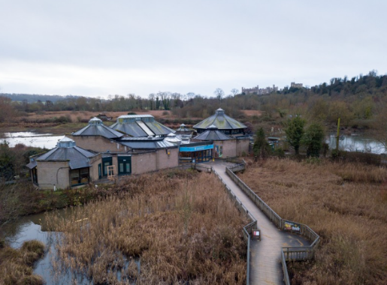
The entrance to the wetland is across a bridge.
There may be a queue with other people waiting to go in.

Slide 3
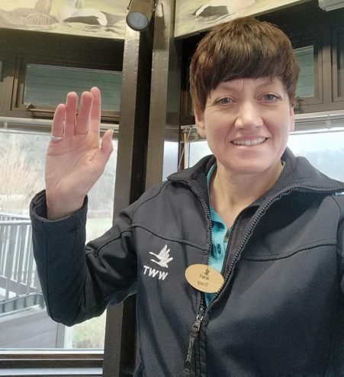
There are staff to help you on your visit.
They will be wearing blue or pink uniforms.
They can help if you are lost, worried or if you have a question about the wetland.

Slide 4
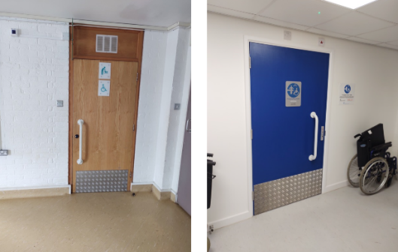
There are several toilets.
There are accessible toilets in the car park and a changing places toilet in the visitor centre.

Slide 5
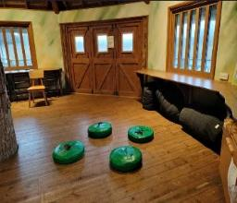
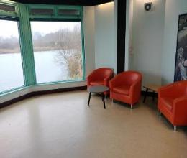
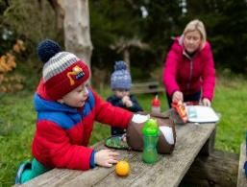
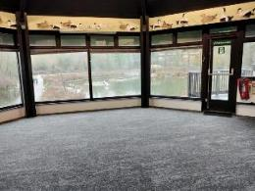
You might eat your lunch in one of our rooms.
If the weather is nice, you might eat outside in one of our picnic areas.

Slide 6
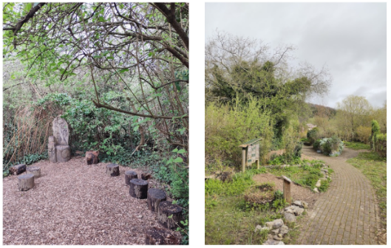
There are areas that are quieter and calmer.
This includes the Log Circle and the Wildlife Garden.
If you need to go somewhere quiet, you can ask a member of staff to help.

Slide 7
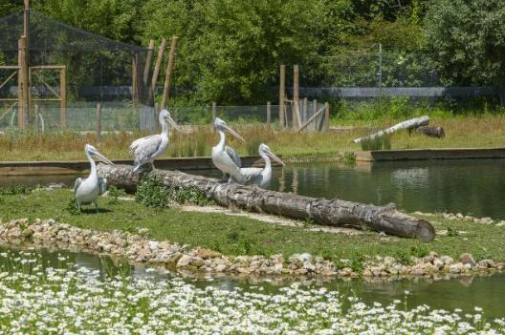
You will see different animals from around the world.
Some of the animals will be in enclosures and others will be out in the open.

Slide 8
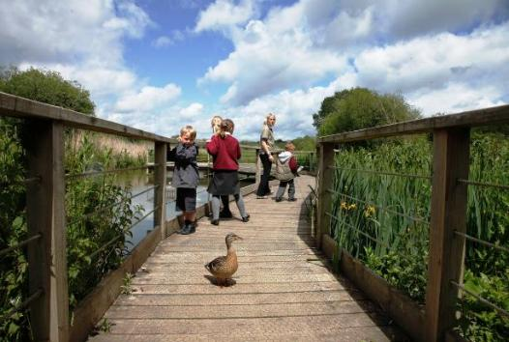
Animals will sometimes walk on the paths!

Slide 9
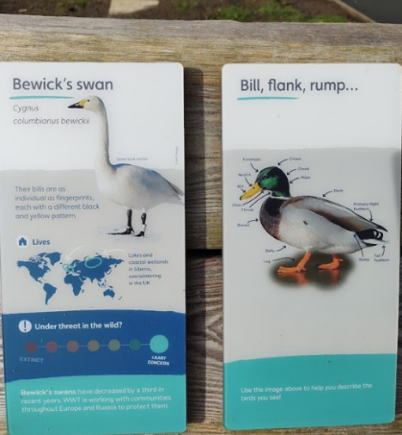
You can find out more about the animals on the information boards.

Slide 10
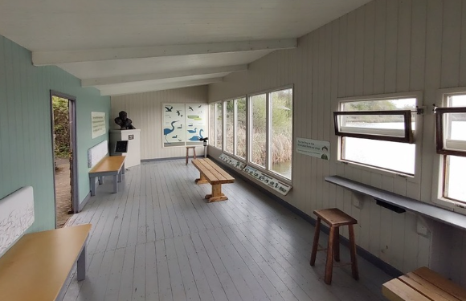
There are six hides where you can watch the wildlife.
The photo is of the Discovery Hide.

Slide 11
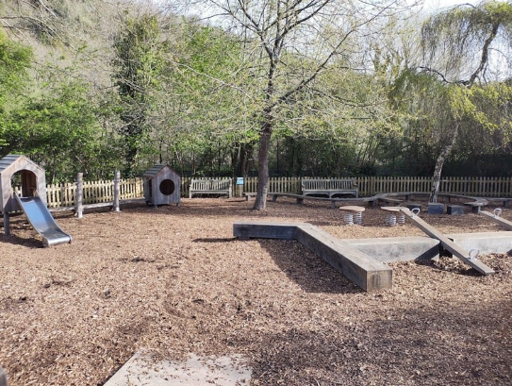
There is a playground that you can play in if there is time.
This is often a bit louder than other areas of the site.

Slide 12
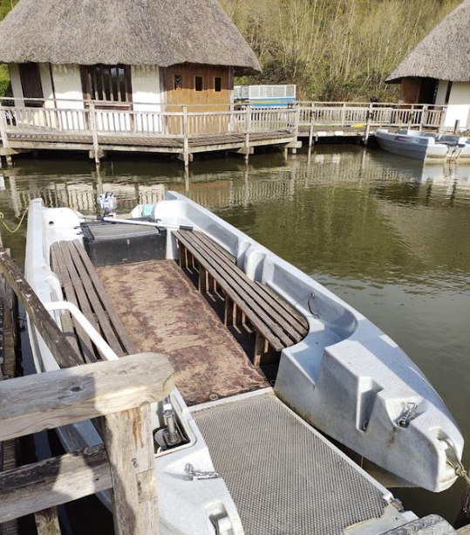
Your teacher might arrange for you to go on a boat.

Slide 13
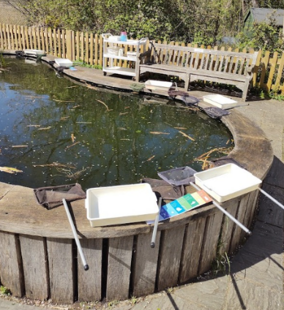
The Pond Zone is where you might use nets to catch pond creatures.

Slide 14
We hope you enjoy your visit to
Arundel Wetland Centre

