Slide 1

Castle Espie Wetland Centre
Visual Guide

Slide 2
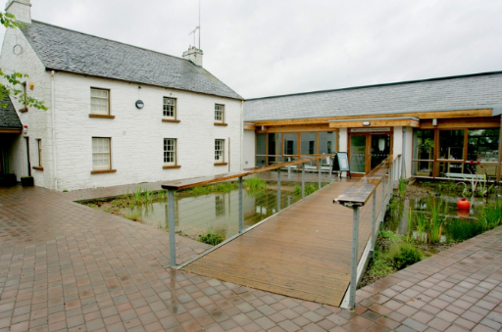
The entrance to the wetland is across a bridge.
There may be a queue with other people waiting to go in.

Slide 3
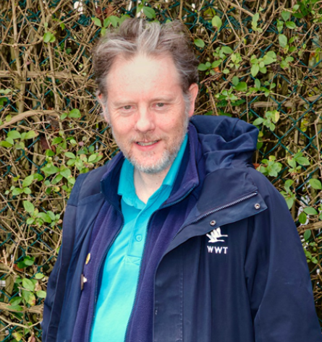
There are staff and volunteers to help you on your visit.
They will be wearing blue or pink uniforms.
They can help if you are lost, worried or if you have a question about the wetland.

Slide 4
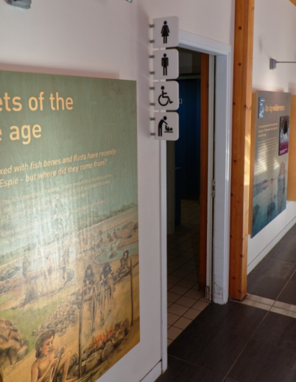
There are several toilets across the wetland centre.
There are accessible toilets in the car park and the visitor centre.

Slide 5
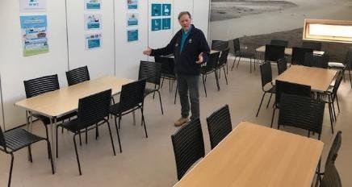
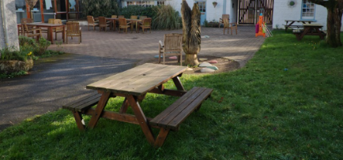
You might eat your lunch in one of our rooms.
If the weather is nice, you might eat outside in one of our picnic areas.

Slide 6
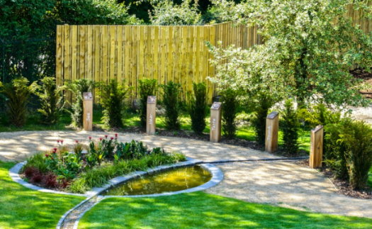
There are areas that are quieter and calmer.
This includes our Sensory Garden.

Slide 7
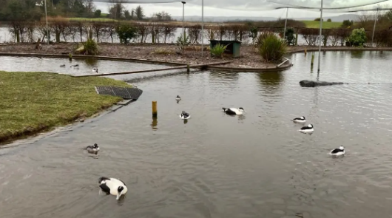
You will see different animals from around the world.
Some of the animals will be in enclosures and others will be out in the open.

Slide 8
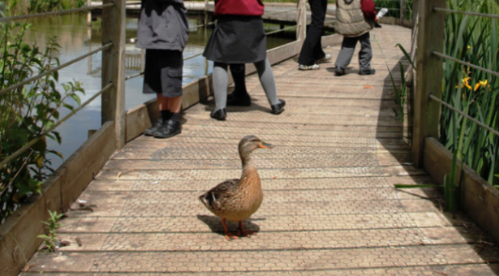
Animals sometimes walk on the paths!

Slide 9
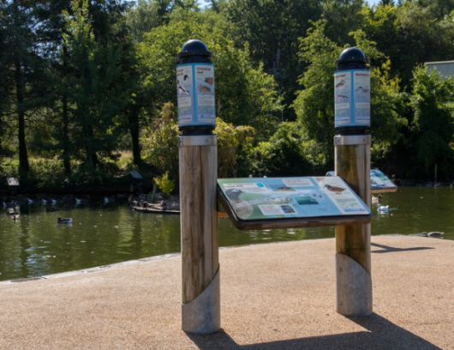
You can find out more about the animals on the information boards.

Slide 10
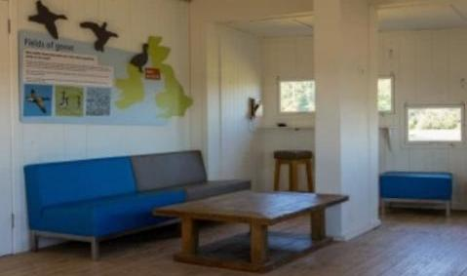
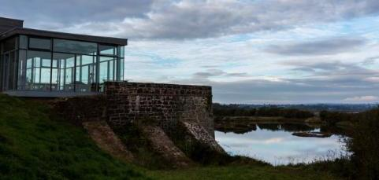
There are hides where you can watch the wildlife.

Slide 11
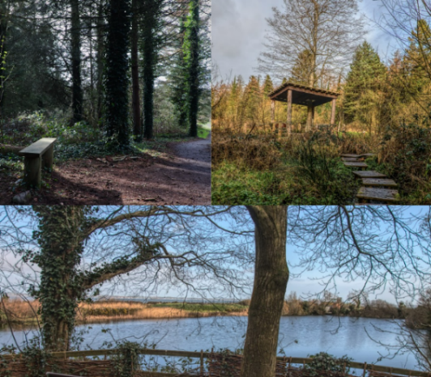
There are lots of different landscapes.
You might go to the woodland, the swamp or our lakes and ponds.

Slide 12
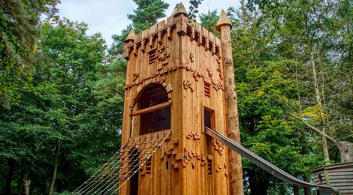
If you have time, there is a playground that you can play in.
This is often a bit louder than other areas of the site.

Slide 13
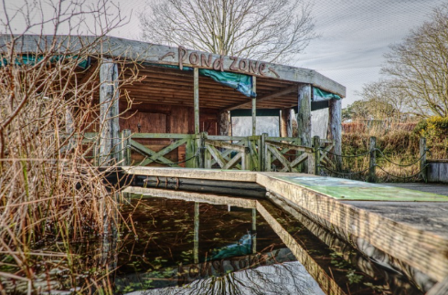
The Pond Zone is where you might use nets to catch pond creatures.

Slide 14
We hope you enjoy your visit to
Castle Espie Wetland Centre

