Slide 1

Llanelli Wetland Centre
Visual Guide

Slide 2
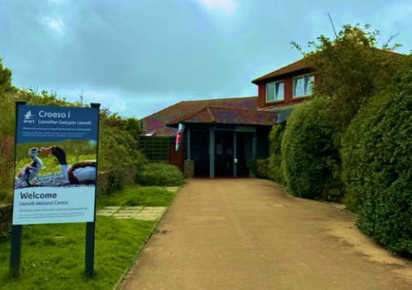
Here is the entrance to the wetland site.
There may be a queue with other people waiting to go in.

Slide 3
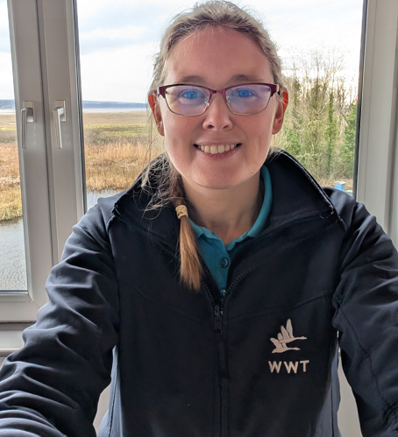
There are staff to help you on your visit.
They will be wearing blue or pink uniforms with a swan on.
They can help if you are lost, worried or if you have a question about the wetland.

Slide 4
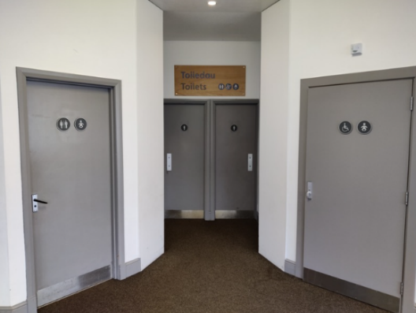
There are several toilets at the wetland centre.
There are two accessible toilets in the main centre building.

Slide 5
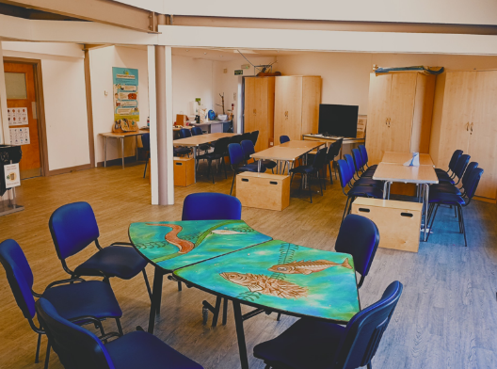
You might eat your lunch in this room.
If the weather is nice, you might eat outside in one of our picnic areas.

Slide 6
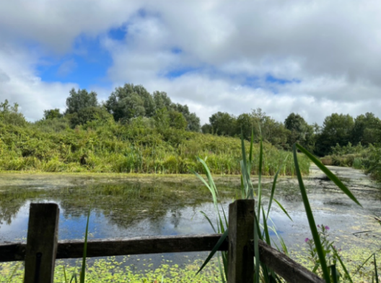
There are areas that are quieter and calmer.
Ask one of our staff members where you can find quieter areas.

Slide 7
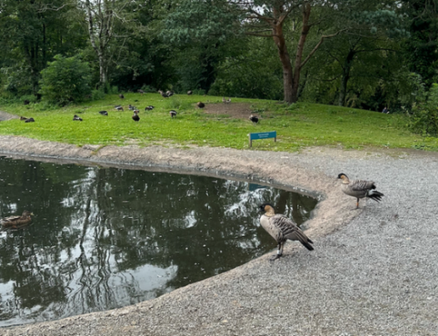
You will see different animals from around the world.
Some of the animals will be in enclosures and others will be out in the open.

Slide 8
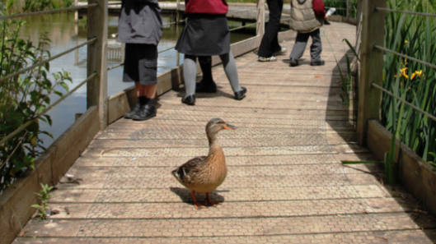
Animals sometimes walk on the paths!

Slide 9
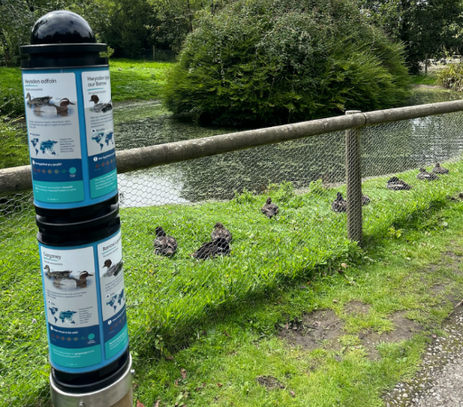
You can find out more about the animals on the information boards.

Slide 10
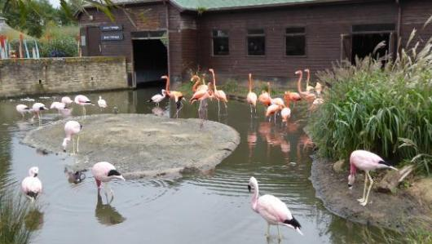
Sometimes our flamingos are outside.
At other times they will be in their house.

Slide 11
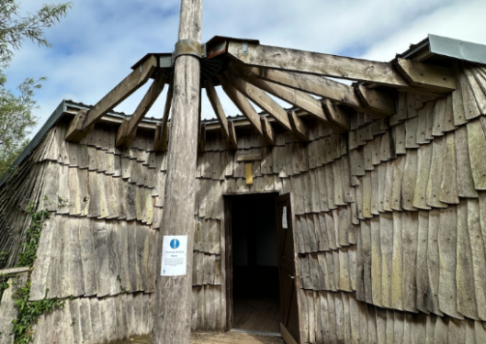
There are different hides where you can watch the wildlife.
Here is our Heron’s Wing hide.

Slide 12
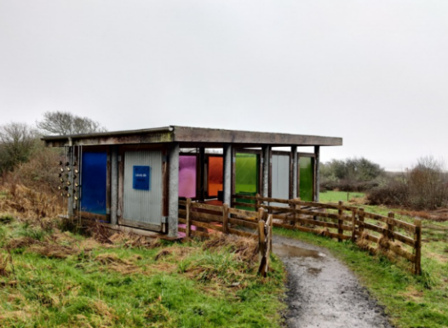
You can have fun making the waterwheel turn and the cups tip in our water lab.

Slide 13
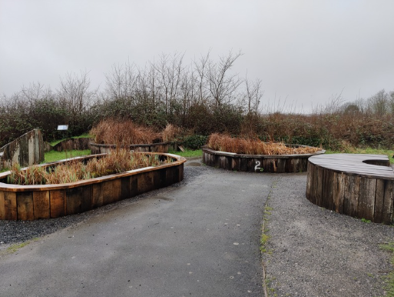
The Pond Zone is where you might use nets to catch pond creatures.

Slide 14
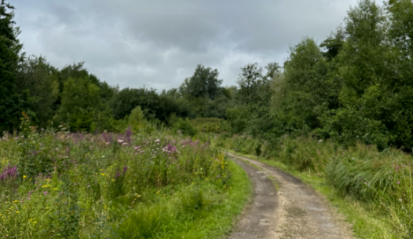
There are gardens and meadows. These are often quieter areas.

Slide 15
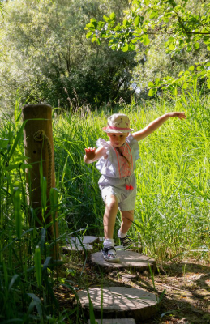
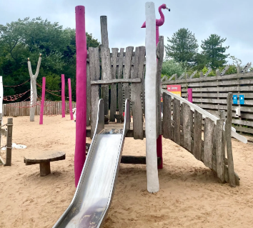
There are playgrounds that you can play in if there is time.
These are often a bit louder than other areas of the site.

Slide 16
We hope you enjoy your visit to
Llanelli Wetland Centre

