Slide 1

London Wetland Centre
Visual Guide

Slide 2
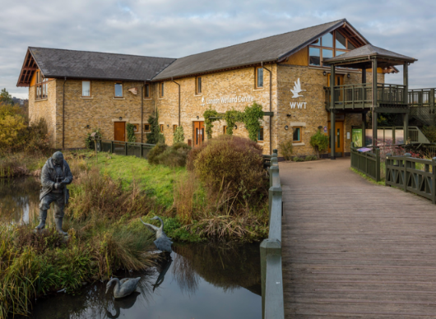
The entrance to the wetland is across a bridge.
There may be a queue with other people waiting to go in.

Slide 3
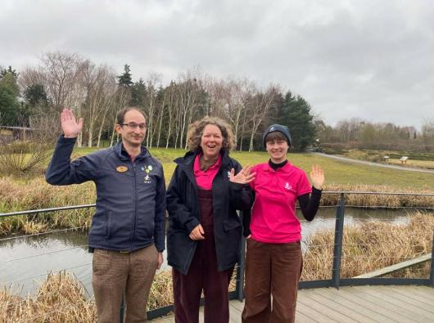
There are staff and volunteers to help you on your visit.
They will be wearing blue or pink uniforms.

Slide 4
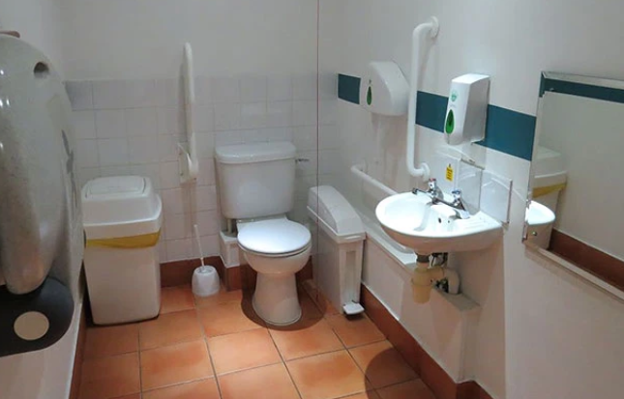
There are several toilets across the wetland centre.
There are accessible toilets in the car park and the visitor centre.

Slide 5
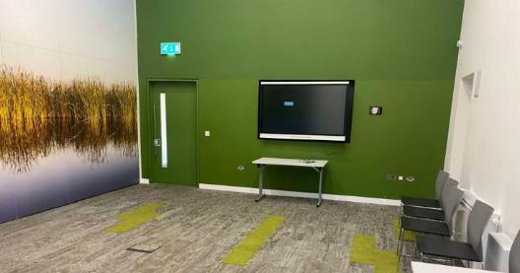
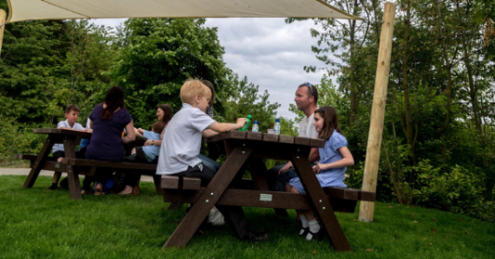
You might eat your lunch in one of our rooms.
If the weather is nice, you might eat outside in one of our picnic areas.

Slide 6
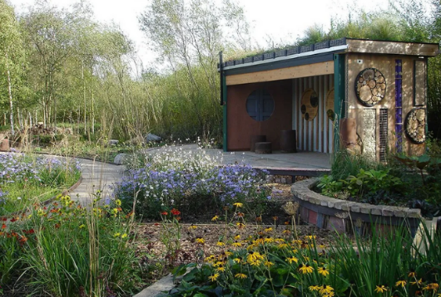
There are areas that are quieter and calmer.
This includes the Slate Garden and the Rain Garden.

Slide 7
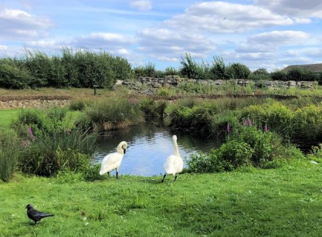
You will see different animals from around the world.
Some of the animals will be in enclosures and others will be out in the open.

Slide 8
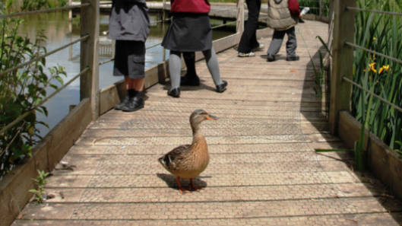
Animals sometimes walk on the paths!

Slide 9
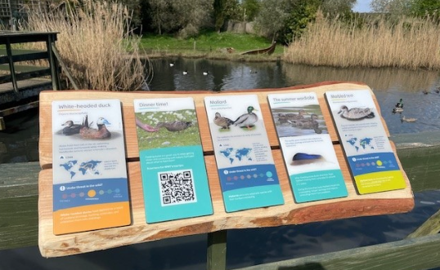
You can find out more about the animals on the information boards.

Slide 10
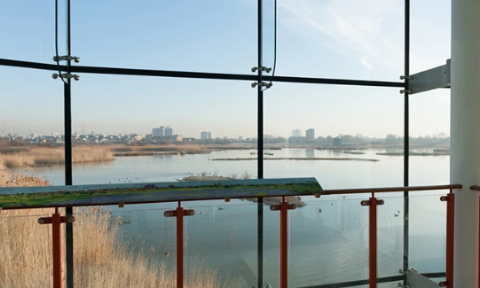
You can watch the wildlife from our observatory.

Slide 11
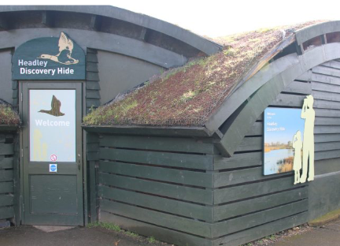
There are also six hides where you can watch the wildlife.
This example is the Headley Hide.

Slide 12
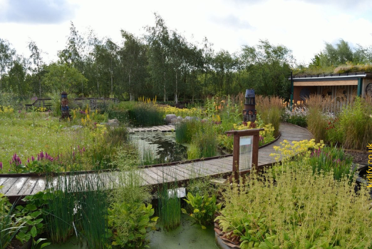
There a several gardens.
These are often quieter areas.
This garden is called the Rain Garden.

Slide 13
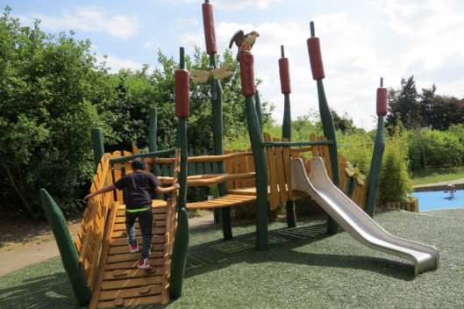
If there’s time you might play in the Adventure Playground.
There are lots of activities here including zip lines and giant tunnels.

Slide 14
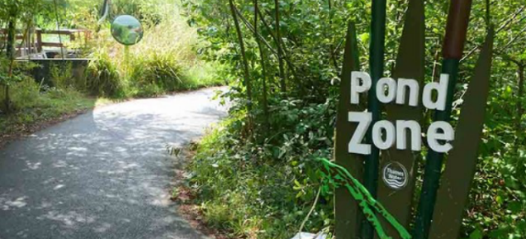
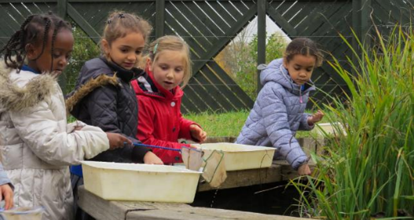
The Pond Zone is where you might use nets to catch pond creatures.

Slide 15
We hope you enjoy your visit to
London Wetland Centre

