Slide 1

Martin Mere Wetland Centre
Visual Guide

Slide 2
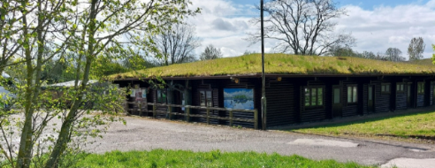
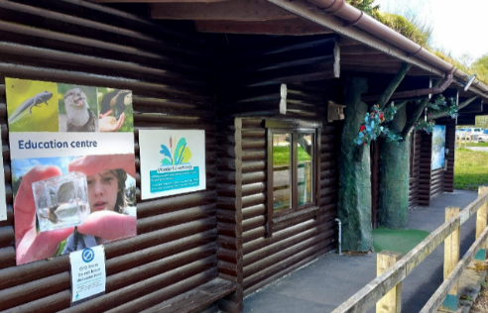
This is the separate entrance for schools.

Slide 3
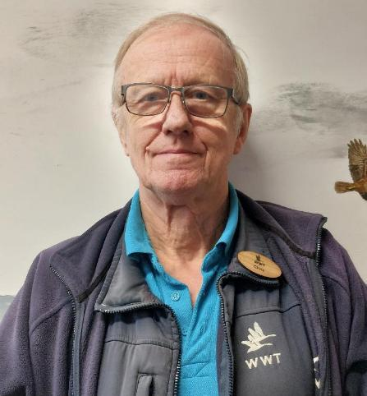
There are staff to help you on your visit.
They will be wearing blue or pink uniforms with a swan on.
They can help if you are lost, worried or if you have a question about the wetland.

Slide 4
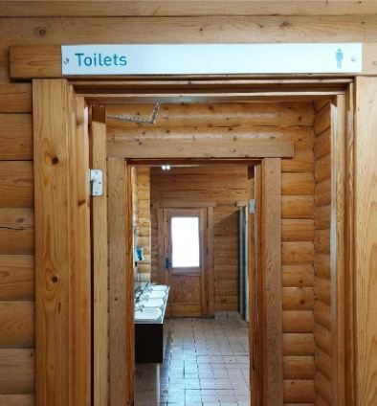
There are several toilets.
There are accessible toilets in the car park and the visitor centre.

Slide 5
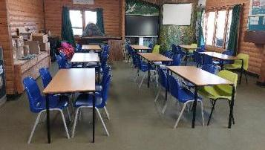
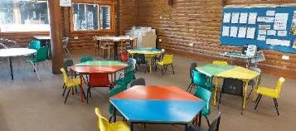
You might eat your lunch in one of our rooms.

Slide 6
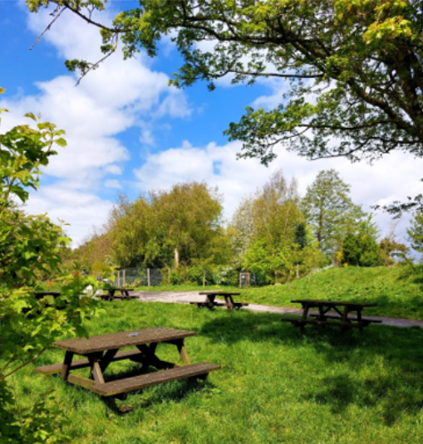
If the weather is nice, you might eat outside in one of our picnic areas.

Slide 7
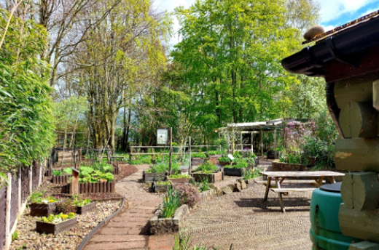
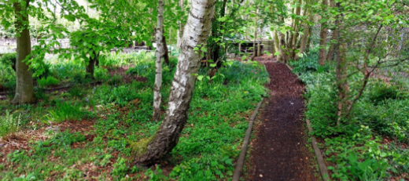
There are areas that are quieter and calmer.
You can visit our Eco-Garden and our Woodland Walk which are a bit quieter.

Slide 8
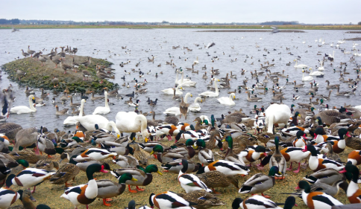
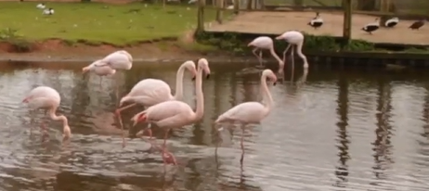
You will see different animals from around the world.
Some of the animals will be in enclosures and others will be out in the open.

Slide 9
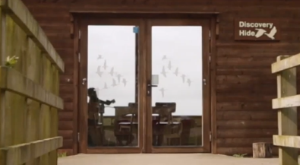
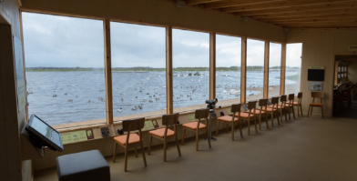
You can look at wildlife from hides.
These photos are of the Discovery Hide.

Slide 10
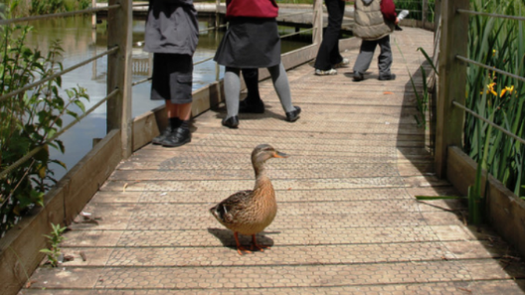
Animals sometimes walk on the paths!

Slide 11
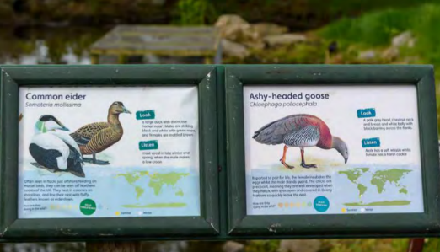
You can find out more about the animals on the information boards.

Slide 12
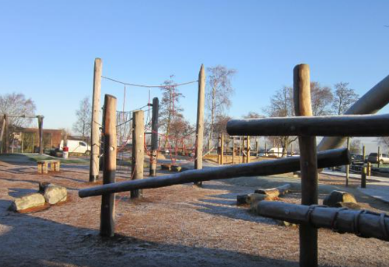
There is a playground that you can play in if there is time.
This is often a bit louder than other areas of the site.

Slide 13
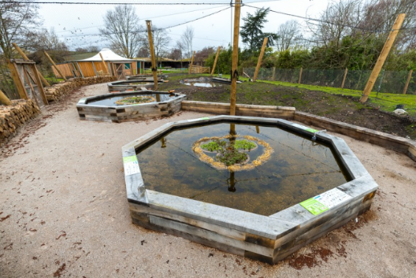
The Pond Zone is where you might use nets to catch pond creatures.

Slide 14
We hope you enjoy your visit to
Martin Mere Wetland Centre

