Slide 1

Washington Wetland Centre
Visual Guide

Slide 2
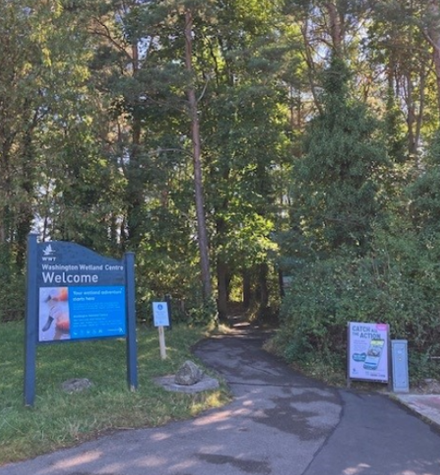
To enter, you walk down this path from the car park.

Slide 3
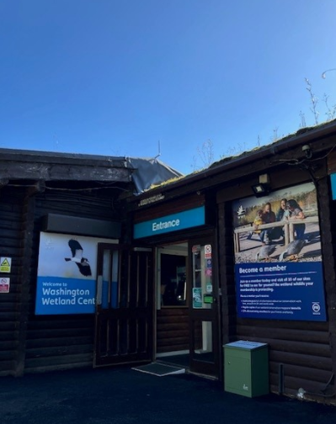
Here is the entrance door.
There may be a queue with other people waiting to go in.

Slide 4
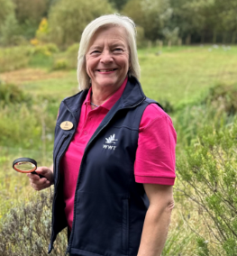
There are staff to help you on your visit.
They will be wearing blue or pink uniforms.

Slide 5
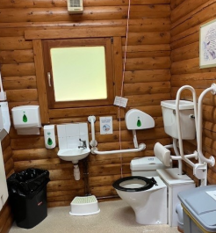
There are two accessible toilets.
One is located inside the visitor centre.

Slide 6
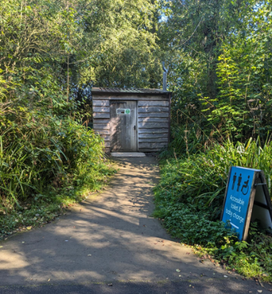
One is outside.

Slide 7
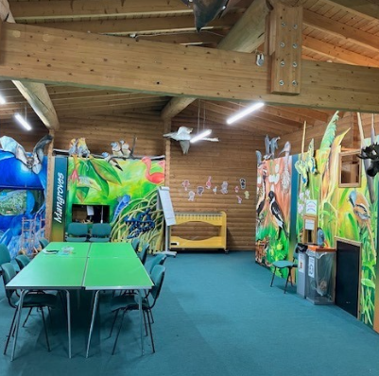
You might eat your lunch in one of our rooms.
If the weather is nice, you might eat outside in one of our picnic areas.

Slide 8
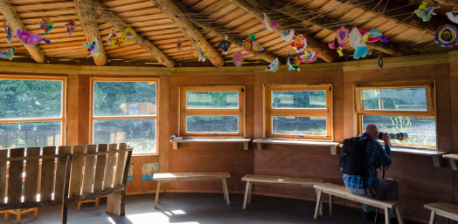
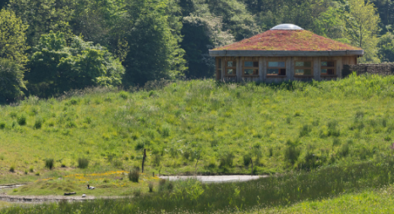
There are areas of that are quieter and calmer.
These include Spring Gill and Lagoon Hide.

Slide 9
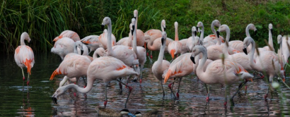
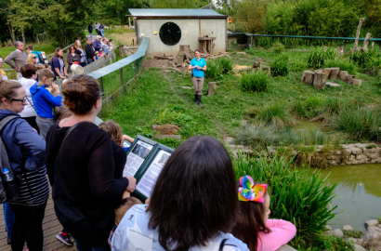
You will see different animals from around the world.
Some of the animals will be in enclosures and others will be out in the open.

Slide 10
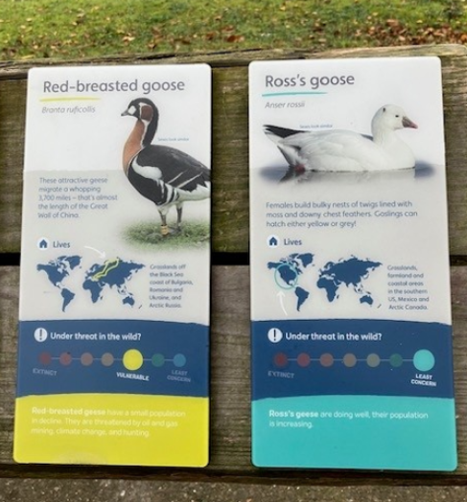
You can find out more about the animals on the information boards.

Slide 11
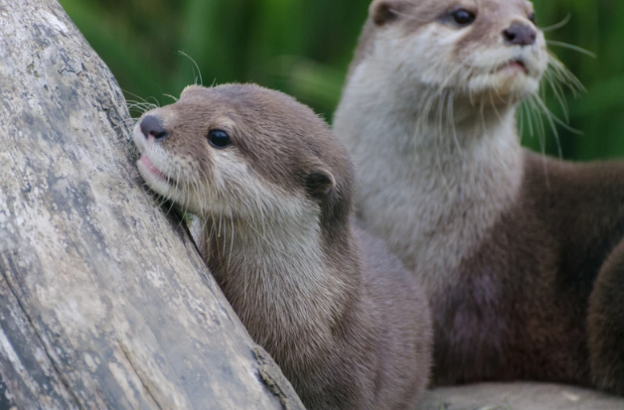
You can watch the otters have their daily feed and one of the team will tell you a bit more about them!
Their names are Mimi, Musa, and Buster.

Slide 12
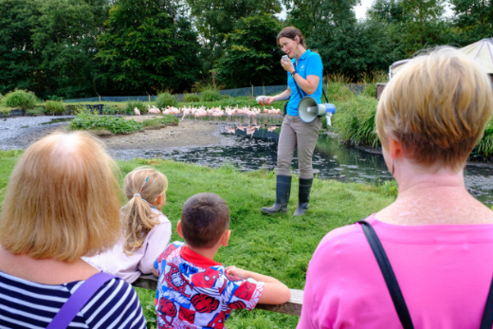
You can also see our Chilean Flamingoes have their daily feed and learn more about them from the keeper.

Slide 13
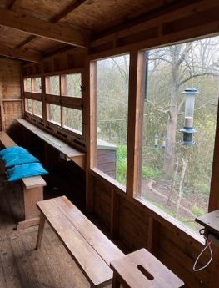
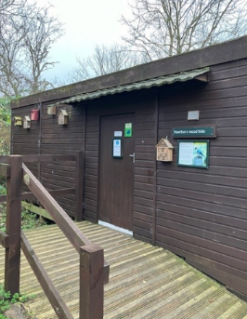
There are seven hides where you can watch the wildlife.
This photo is of the Heathers Wood Hide.

Slide 14
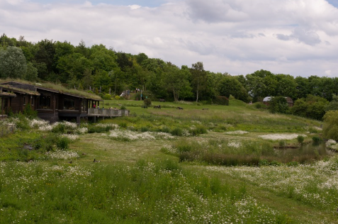
There a several meadows and gardens.
These tend to be a bit quieter.

Slide 15
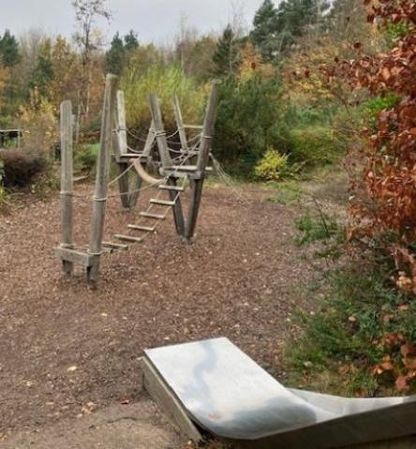
There is a playground that you can play in if there is time.
This is often a bit louder than other areas of the site.

Slide 16
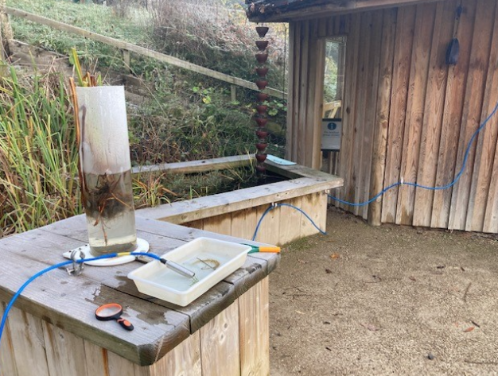
The Pond Zone is where you might use nets to catch pond creatures.

Slide 17
We hope you enjoy your visit to
Washington Wetland Centre

