Slide 1

School Visit Social Story

Slide 2


We will travel on a coach/bus with the class.
We will go to the entrance with our class.

Slide 3
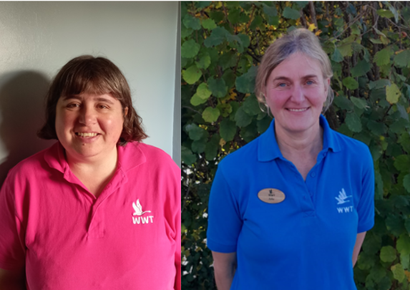
At the entrance we will meet our WWT teacher.
Staff wear blue or pink uniforms with a swan on.

Slide 4
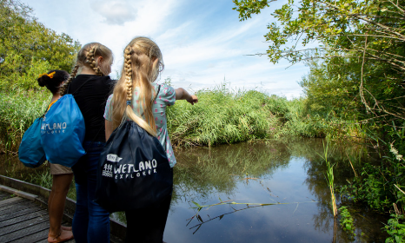
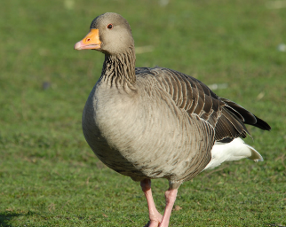
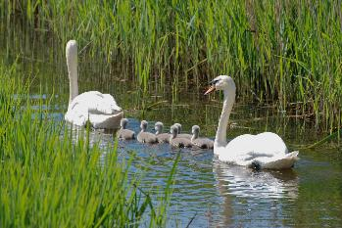
WWT centres are wetlands.
This means we will see lots of different wildlife like birds and plants.

Slide 5


We might have a snack before starting the activities.
We might put our bags in a safe place.

Slide 6
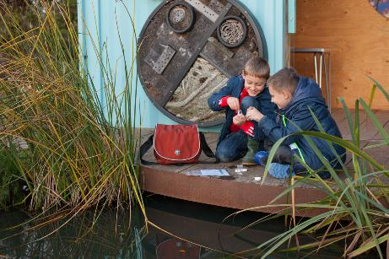
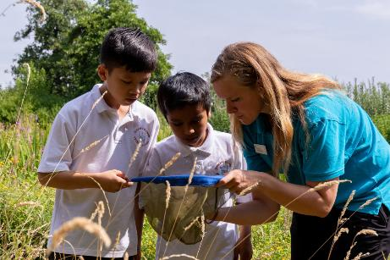
We will then do some activities to learn about wetlands.

Slide 7

We will then eat lunch.
This might be inside or outside.
Notes:
NOTE: This is an optional slide!! Many people like to keep this part of the visit as a surprise. You know

Slide 8
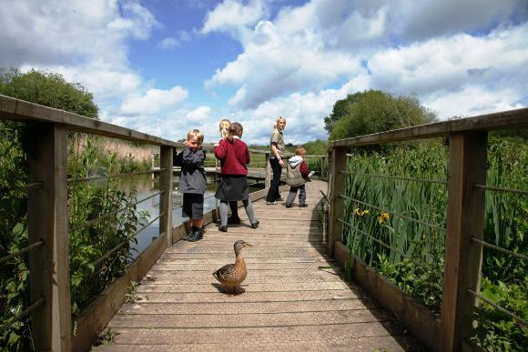
Some of the animals may come close to us.
Notes:
NOTE: This is an optional slide!! Many people like to keep this part of the visit as a surprise. You know

Slide 9
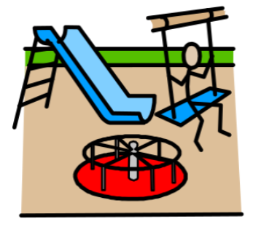
If there is time we might go to a playground
This place may be louder.
There may be lots of people talking and playing.
Notes:
NOTE: This is an optional slide!! Many people like to keep this part of the visit as a surprise. You know

Slide 10


When it is time to leave, we will get our things and say goodbye.
It will then be time to travel back to school.
Notes:
NOTE: This is an optional slide!! Many people like to keep this part of the visit as a surprise. You know

Slide 11
We look forward to seeing you at the wetland centre!

